Slide 1
Marine Physics
Preparation By Instructed Bushra Majeed Issa

Slide 2
What is meaning of Marine Physics?
∗Marine Physics is one of several sub-domains in oceanography and it is the study of physical conditions and physical processes within the ocean, especially the motions and physical properties of ocean waters.

Slide 3
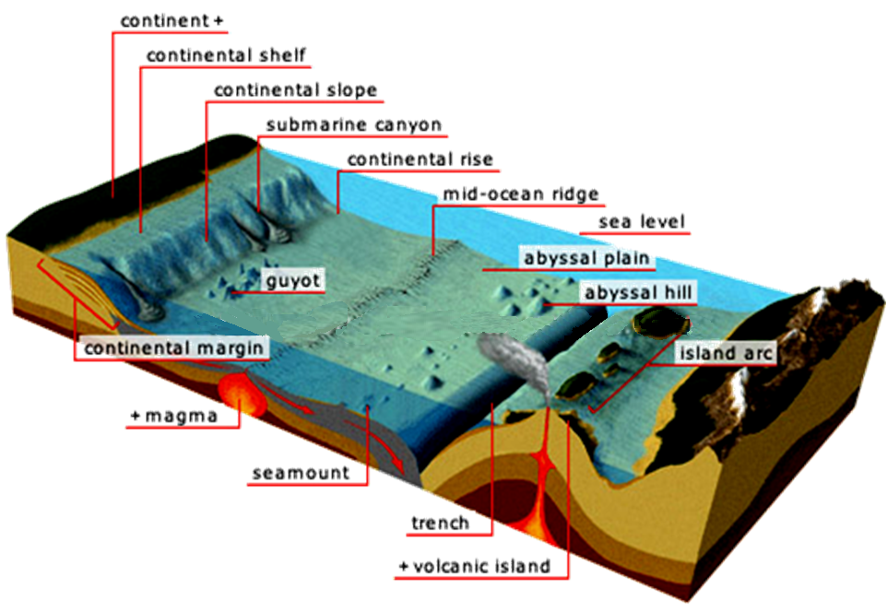
Features of the Ocean Floor

Slide 4
∗ Continental shelf :is the extended perimeter of each continent and associated coastal plain, and was part of the continent during the glacial periods, but is undersea during interglacial periods.
∗Continental slope:the descending slope which connects the sea floor to the Continental shelf. This is still considered to be part of the Continent.

Slide 5
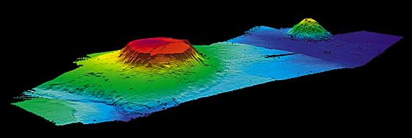
∗Continental rise: a gentle slope with a generally smooth surface, built up by the shedding of sediments from the continental block, and located between the continental slope and the abyssal plain.
∗Guyot: a guyot also known as a tablemount, is a flat-topped seamount. Their flatness is due to erosion by waves, winds, and atmospheric processes.

Slide 6
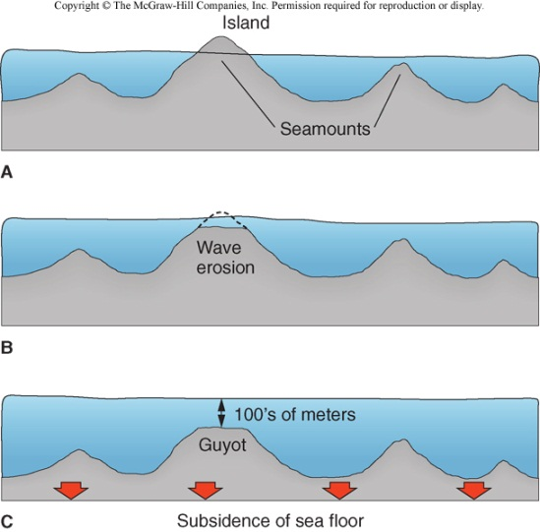

Slide 7
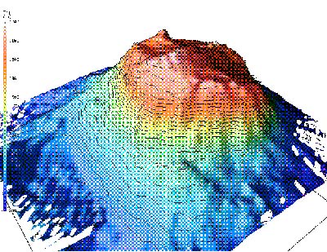
∗Sea Mount: a seamount is a mountain rising from the ocean seafloor that does not reach to the water's surface (sea level), and thus is not an island. These are typically formed from extinct volcanoes, that rise abruptly.

Slide 8
∗Abyssal hills: Hills along the ocean floor. Ranging in height and diameter, these hills are much larger than the hills we see on land. 100-2000 meters high and several KM across.
∗Abyssal plains: are flat or very gently sloping areas of the deep ocean basin floor. They generally lie between the foot of a continental rise and a mid-oceanic ridge.

Slide 9
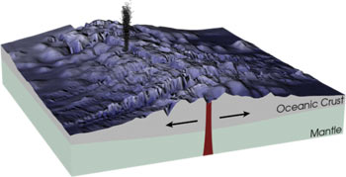
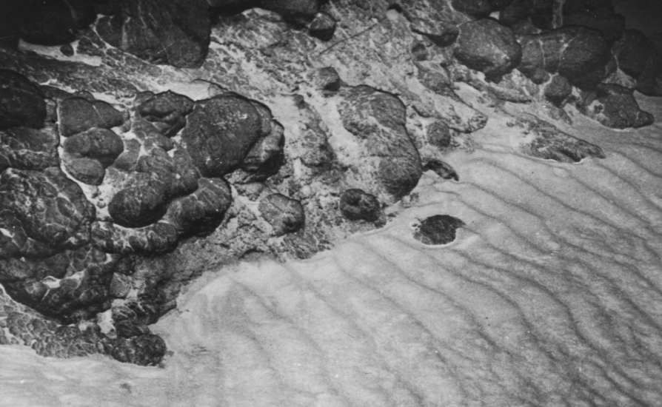
∗Mid-Ocean ridge: a mid-ocean ridge is an underwater mountain range, typically having a valley known as a rift running along its spine, formed by plate tectonics. It is usually an oceanic spreading center, which is responsible for seafloor spreading.

Slide 10
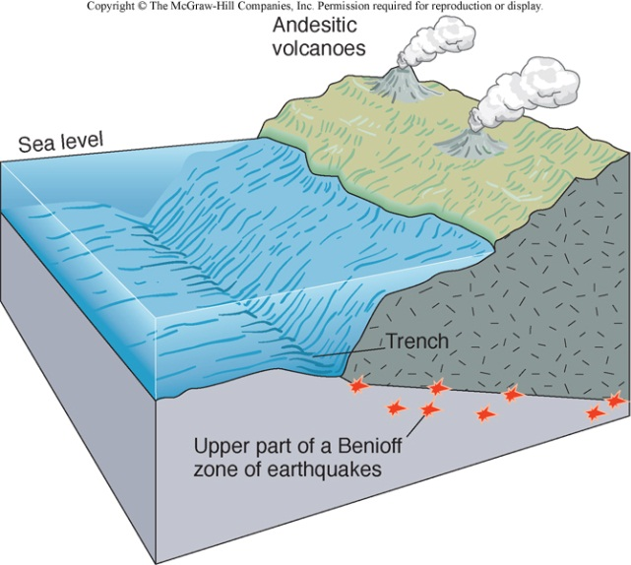
∗Trench: the oceanic trenches are hemispheric-scale (one hemisphere to another) long but narrow topographic depressions of the sea floor. They are also the deepest parts of the ocean floor.

Slide 11
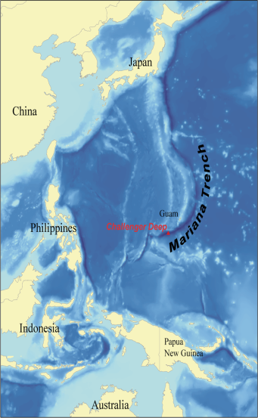
Mariana Trench is the deepest part of the world's oceans, and the deepest location on the surface of the Earth's crust. It has a maximum depth of about 10.911meters, or 11 kilometers.

Slide 12
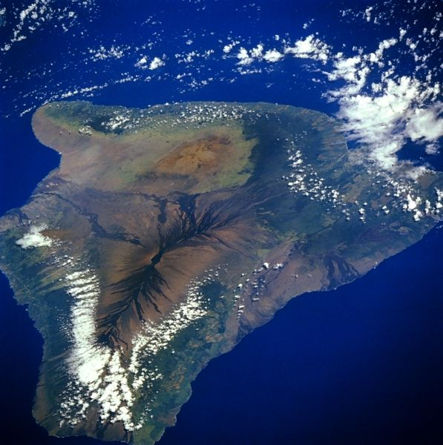
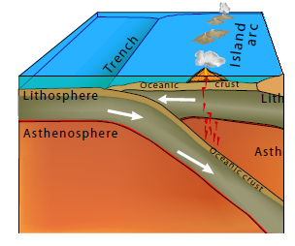
∗Oceanic Island: one type of oceanic island is found in a volcanic island arc. These islands arise from volcanoes where the subduction of one plate under another is occurring.

Slide 14
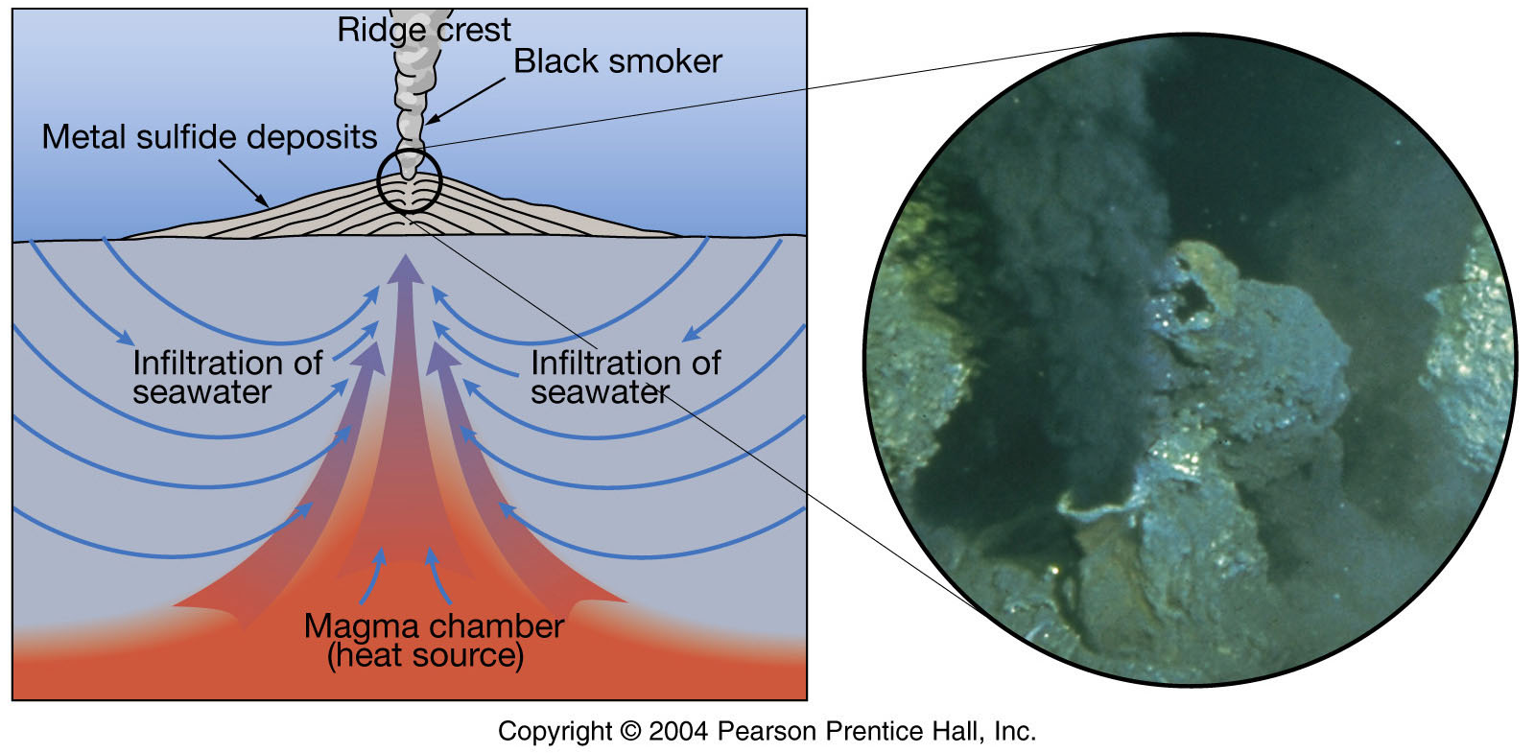
∗Hydrothermal Vents: hot springs which occur in the central rift valley, appearance depends on temperature of water;
  -Warm-water vents are below 30ºC and are clear in color.
  -White smokers are between 30ºC and 350ºC and are white in color.
  -Black smokers are above 350ºC and are black in color.

Slide 15
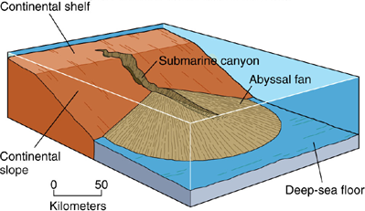
∗ Submarine canyons : V-shaped valleys that run across continental shelves and down continental slopes.

